Slide 1
Dependency Parsing

Slide 2
Introduction
In some languages, the same statement can be written in such a way that on translating in English (word to word translation), it might yield ‘He is standing wall behind’ i.e the word order is free.
It isn’t necessary the adjective has to appear just before the noun it like ‘Handsome boy’.
It can be ‘Boy handsome’.
Hence, using rules for parsing such languages is problematic!!
And that is why dependency parsing is required.

Slide 3
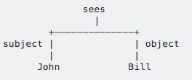
Dependency Parsing
Dependency parsing helps us build a parsing tree with the tags used determining the relationship between words
in the sentence rather than using any Grammar rule as used for syntactic parsing which gives a lot of flexibility even when the order of words (like ‘boy handsome’ or ‘handsome boy’) get changed.
A sample dependency tree can be observed below:

Slide 4
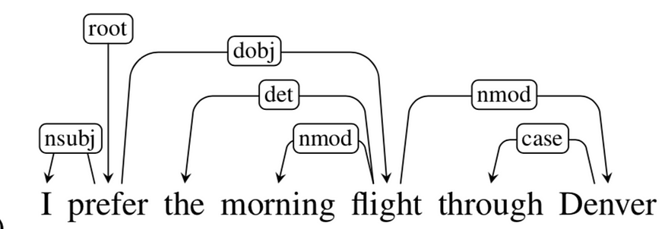
Below is an example of Dependency parsing for:
‘I prefer the morning flight through Denver’

Slide 5
terminologies as well used for Dependency parsing
Head-Dependent:
In the arrows representing relationship, the origin word is the Head & the destination word is Dependent.
For example: (I, ‘nsubj’, prefer), ‘prefer’ is Head & ‘I’ is Dependent.
Root: Word which is the root of our parse tree. It is ‘prefer’ in the above example.

Slide 6
terminologies as well used for Dependency parsing
Grammar Functions and Arcs: Tags between each Head-Dependent pair is a grammar function determining the relation between the Head & Dependent.
The arrowhead carrying the tag is called an Arc. Below is the table that interprets the meaning of some common grammar functions:

Slide 7
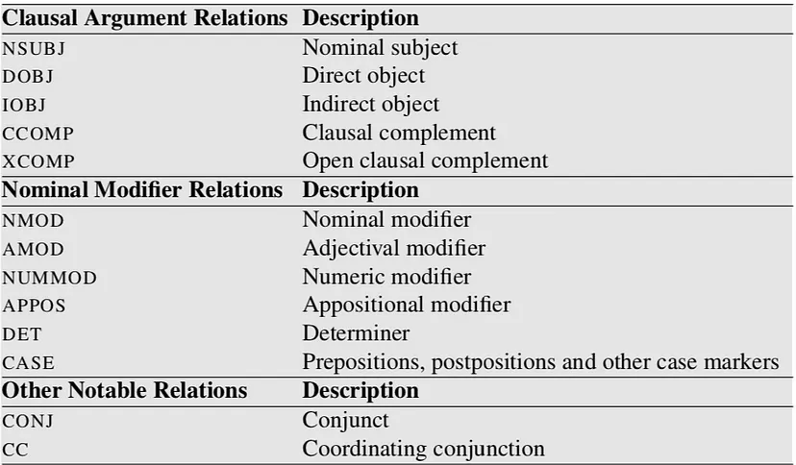
Some examples for Grammar Functions are given below:

Slide 8
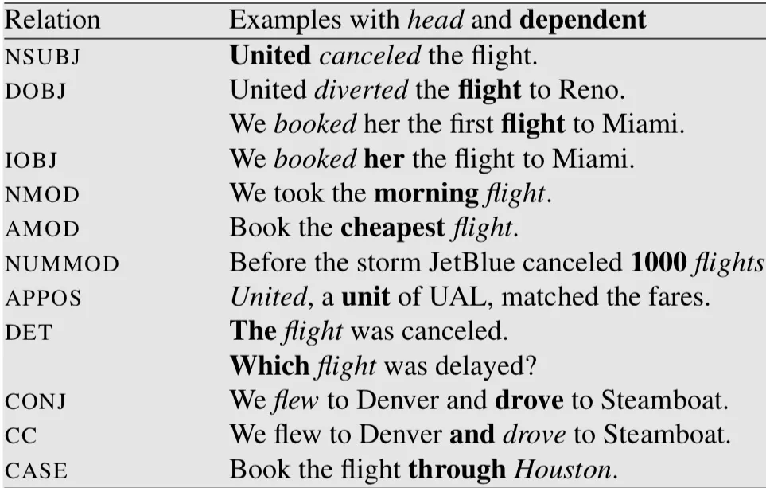
Some examples for Grammar Functions are given below:

Slide 9
Understanding the Dependency parse tree
we represent dependencies as a directed graph G= (V, A)
where V(set of vertices) represents words (and punctuation marks as well) in the sentence &
A( set of arcs) represent the grammar relationship between elements of V.

Slide 10
Understanding the Dependency parse tree
A dependency parse tree is the directed graph mentioned above which has the below features:
Root has no Incoming arcs (can only be Head in Head-Dependent pair)
Vertices(except Root) should have only one incoming arc (Only one Parent/Head)
A Unique path should exist between Root & each vertex in the tree.

Slide 11
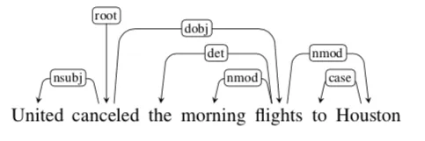
Projectivity
Projective arc: An arc/arrows_with_tag are projective when ‘Head’ associated with the arc has a path to reach each word that lies between ‘Head’ & ‘Dependent’.

Slide 12
Explanation
Here, the arc between ‘the’ & ‘flights’ is projective as the ‘Head’ i.e ‘flights’ has a path to ‘morning’ as well which lies between ‘the’ & ‘flights. Similarly, arc between ‘canceled’ & ‘flights’ is also projective as ‘canceled’ has a path to ‘the’(canceled →flights →the) & ‘morning’ (canceled →flights →morning) which lies between Head ‘canceled’ & Dependent ‘flights’

Slide 13
Projective and Non-Projective Parse Tress
Projective parse tree: A parse tree with all its arcs projective. The above tree is projective.
Non-projective parse tree: A tree with at least one of the arcs as non-projective. Have a look at the below example

Slide 14
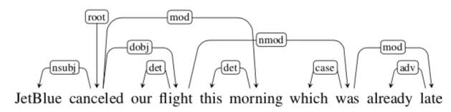
Non-Projective Parse Tree Example
Here, the arc between ‘flight’ & ‘was’ is non-projective as there exists no path between ‘flight’ & ‘morning’

Slide 15
how to create a dependency parse tree-Shift Reduce Parsing (Arc standard):
We need some setup for this algorithm:
A Stack
Buffer of input words
Oracle function/parser & set of dependency relations (like obj, iobj, etc tags that are used to represent arcs).

Slide 16
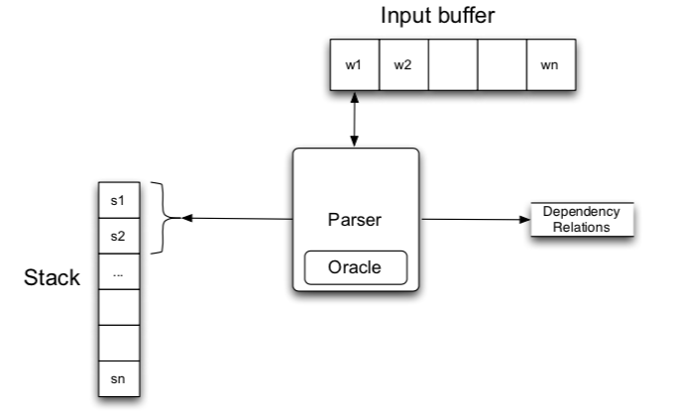

Slide 17
Initially, the Stack has [Root], a dummy variable.
All the words of the sentence to be parsed are in the buffer.
A word is popped from buffer & pushed in Stack.
As a word is pushed in Stack, the Oracle/parser takes the top two elements of the stack & outputs/predict any of the below 3 transition with relationship type:
LEFTARC_FUNCTION:
RIGHTARC_FUNCTION
SHIFT:

Slide 18
Hence, the actual prediction has two parts:
Determining Head & Dependent using LEFTARC/RIGHTARC
Determining their relation type i.e functions like conj, iobj, etc.
Hence the actual predictions done by Oracle are something like this LEFTARC_IOBJ, RIGHTARC_CONJ, etc.
For simplicity purposes, I will be using just LEFTARC & RIGHTARC notations in the below example.
We will stop as & when the buffer is empty & stack has only [Root] left.

Slide 19
Some restrictions are also considered:
No LEFTARC, if we have [Root] as 2nd element of the stack & buffer, is non-empty
At least 2 elements should be Stack for LEFTARC/RIGHTARC transition.
[Root] can never be a dependent (as it is a dummy variable)

Slide 20
A Dependency Treebank is a text corpus in which each sentence has a corresponding dependency tree which is usually either extracted using Syntactic Treebanks(like PennTreebank) or manually marked by humans.

Slide 21
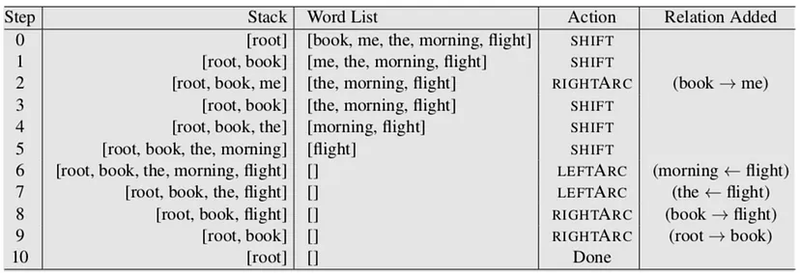
Examples
consider the statement: ‘book me the morning flight’. We will be creating a dependency parse tree for this sentence

Slide 22
Step-0: As Stack has only one element [root], SHIFT is predicted(exception cases mentioned above) & ‘book’ is pushed.
Step-1:[root, book] are popped out from Stack, Oracle predicts SHIFT hence they are put back, and ‘me’ is pushed in Stack.
Step-2:[book, me](top 2 elements of the Stack currently) are popped, Oracle predicts RIGTHARC, hence declaring ‘book’ as Head & ‘me’ as dependent & removing ‘me’ from Stack; pushing back ‘book’ & adding relation:(Book→me)
At last, we can pop ‘root’ & ‘book’ as the buffer is empty(which we avoided in Step-0 due to the exception mentioned). RIGTHARC is the relation detected & with this the parse tree is obtained. Using the relations found, a directed graph can be easily established with ‘book’ as the root node.

